Slide 1



PnP Transformation – Solution Assessment Report
<Consultant Name>
<Role>
<Company>

Slide 2
Note:
This deck is a structure for the solution assessment report

Slide 3
Agenda
Positioning in the PnP Transformation approach
Vision for SharePoint
Supporting work streams
SharePoint Assessment report
Next steps

Slide 4
Positioning in the PnP Transformation approach

Slide 5
Note:
Provide an overview of the Transformation approach

Slide 6
Application Modernization (PnP Transformation Approach)
Customer Preparedness
Solution Assessment
Architecture Session
STEP 1
Empower & Plan
App hosting configuration. Leverage available resources to ramp up Dev resources
Analyze solution inventory / requirements and provide guidance on solution modernization
Provide architecture design guidance for selected scenarios
Deliverable:
Successful smoke test app to validate configuration
Deliverable:
Assessment report
Deliverable:
Architecture Design Report
Development SOW (optional)
Development & Testing
Deployment
STEP 2
Develop & Deploy
Jointly work on development and testing with MS partners
Retract FTC
Deploy App solutions
Deliverable:
Tested solution artifacts
Deployment Guide
Deliverable:
Replace FTC by APP
Project signoff
Notes:
FTC: Full Trust Code
SOW: Statement of Work

Slide 7
Solution Assessment
5 days of assessment. Analyze inventory and provide guidance on app modernization roadmap. Results in a Solution Assessment Report.
Engagement Criteria | Roles & Responsibilities |  | Deliverable
 | Customer | Microsoft Partner
Solution Requirement document FTC application inventory | Live demo Requirement review Rationalize and prioritize application requirements | Assessment workshop FTC analysis Requirement analysis Refine requirement | FTC to APP Assessment report Detailed solution inventory analysis Identify App blockers per scenario
Module Overview
Assessment and focus area selection Day 2-3
Kickoff
Envisioning session
Assessment of existing customization
Solution demo and requirement analysis
Objective refinement
Report
Next steps
Envisioning Day 1
Documentation Day 4-5
Everybody
Stage
IT Admin
IT Admin
Developers
Consultant
Everybody
Audience
Notes:
Evaluate the inventory reports, discuss and prioritize requirements, identify blockers, reference sample implementation guidance and determine the overall transition roadmap

Slide 8
Vision for SharePoint

Slide 9










Why transition to App Model
IT Pro
Scalable Solution
Aligned with service roadmap
Agile and faster deployment
You control release process
Cloud Enabled
Developers
Open APIs
Responsive UI
Cross-Device
Social
Security
Notes:
What is the advantage of the App Model?
Self service agility
Process efficiency
Ability to scale up/out application without affecting the SP farm
App model has following advantages over FTC
Responsive Design for cross device support
Open APIs to empower business solutions and mobile apps
Similar capabilities but with a simpler design

Slide 10
Cloud Ready
Design architecture which supports hosting in private or public cloud
Implementations should be working cross platforms for long term cost benefits
Use methods inline with the product roadmap
Align SharePoint usage patterns with SharePoint roadmap to maximize return on investment

Slide 11
Business Agility
Faster deployment times
Reduces downtime when provisioning new functionalities

Slide 12
Cost Efficiency
Reduces costs by reducing unnecessary complexity
Efficient usage of out of the box capabilities
Evaluate “cost” versus “gain” for every customization
Evaluate both implementation and maintenance cost

Slide 13
Customize for business value
Minimize Customization impact on overall solution
Evaluate out of the box capabilities
Use application model (APP) whenever possible
Create clear business case for every customization requirement
Evaluate the cost versus gained value (ROI)
Notes:
ROI - Return on Investment

Slide 14
Supporting work streams

Slide 15
Note:
Where needed the scenario specific decks as working material to describe the supporting work streams for the customer

Slide 16


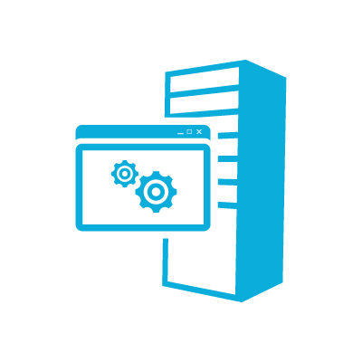

Supporting work streams
Modern responsive apps
App Developer Guidance
Environments and ALM
Provider Hosted App hosting

Slide 17
Modern responsive apps

Slide 18
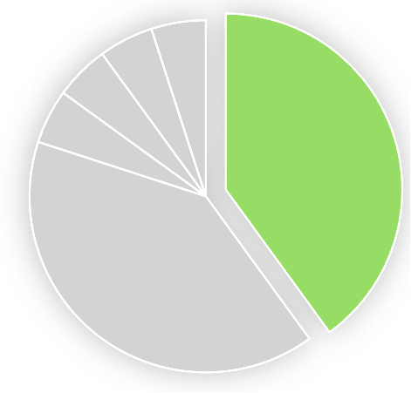
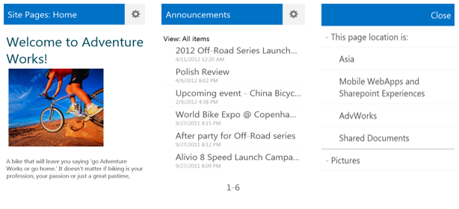
Access Anywhere
What
With the range of highly-capable, secure, always-connected smartphones and tablets growing exponentially, the ability to connect to SharePoint 2013 from anywhere is here.
Considerations
Authentication methods and modes available between devices and network
Phase metrics
Complexity
Required time
Gained value

Slide 19

Access Any Device
What
SharePoint 2013 provides the mobile architecture necessary to connect users to business-critical data and other types of information across multiple device platforms.
Considerations
Leveraging Office Web Apps Server offers a better user experience when interacting with documents on a mobile device
Making use of location data
Push notifications
Supported mobile browsers
Phase metrics
Complexity
Required time
Gained value

Slide 20
App Developer Guidance

Slide 21
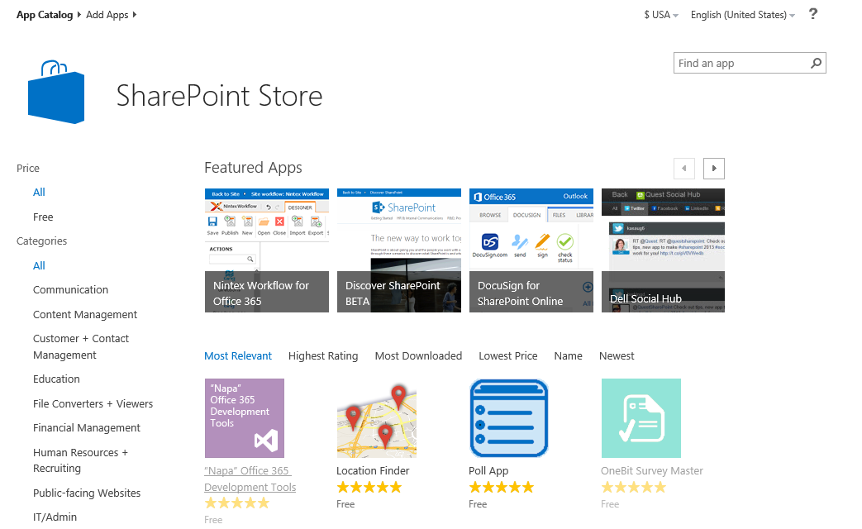
App Developer Guidance
What
Developer guidance for designing and building SharePoint apps that meet requirements and are most suitable for the target environments.
Considerations
Recommended patterns & practices
SharePoint-hosted vs. Provider-hosted
API selection
Phase metrics
Complexity
Required time
Gained value

Slide 22
Environments and ALM

Slide 23
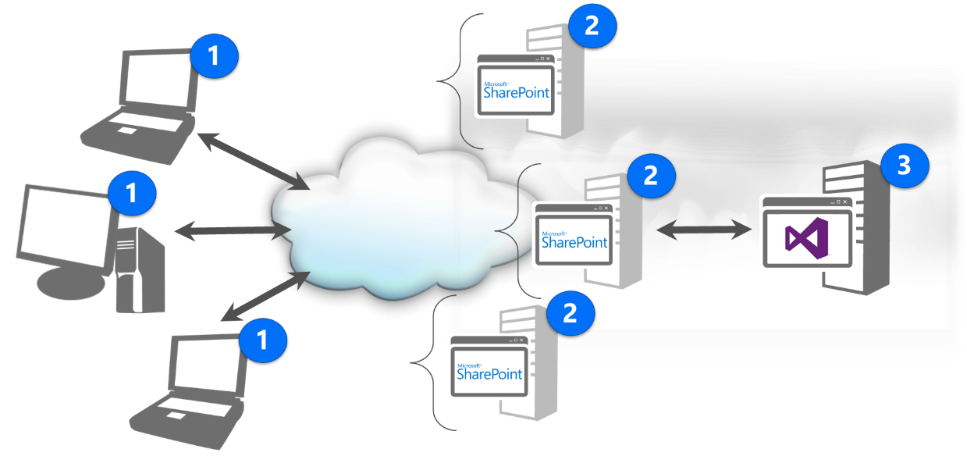
Infrastructure for Dev Environments
What
Provide guidance to help organizations build robust environments that meet the needs of their SharePoint developers.
Considerations
Single vs. Multi Tenanted environments
On-premises, cloud or hybrid
Tooling choices
Integration with ALM
Code promotion
Phase metrics
Complexity
Required time
Gained value
Notes:
Old section: ALM

Slide 24
Infrastructure for QA Environments
What
Provide guidance to help organizations build robust environments that meet the needs of their SharePoint quality assurance staff.
Considerations
Single vs. Multi Tenanted environments
On-premises, cloud or hybrid
Tooling choices
Integration with ALM
Build promotion
Phase metrics
Complexity
Required time
Gained value

Slide 25
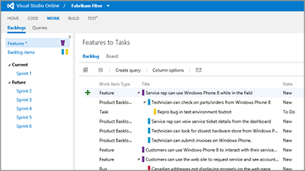
Visual Studio Online
What
Visual Studio Online provides a place to store your code, backlog, and other project data with no servers to deploy, configure, or manage.
Considerations
Plans and pricing
Build and load-testing
Phase metrics
Complexity
Required time
Gained value

Slide 26
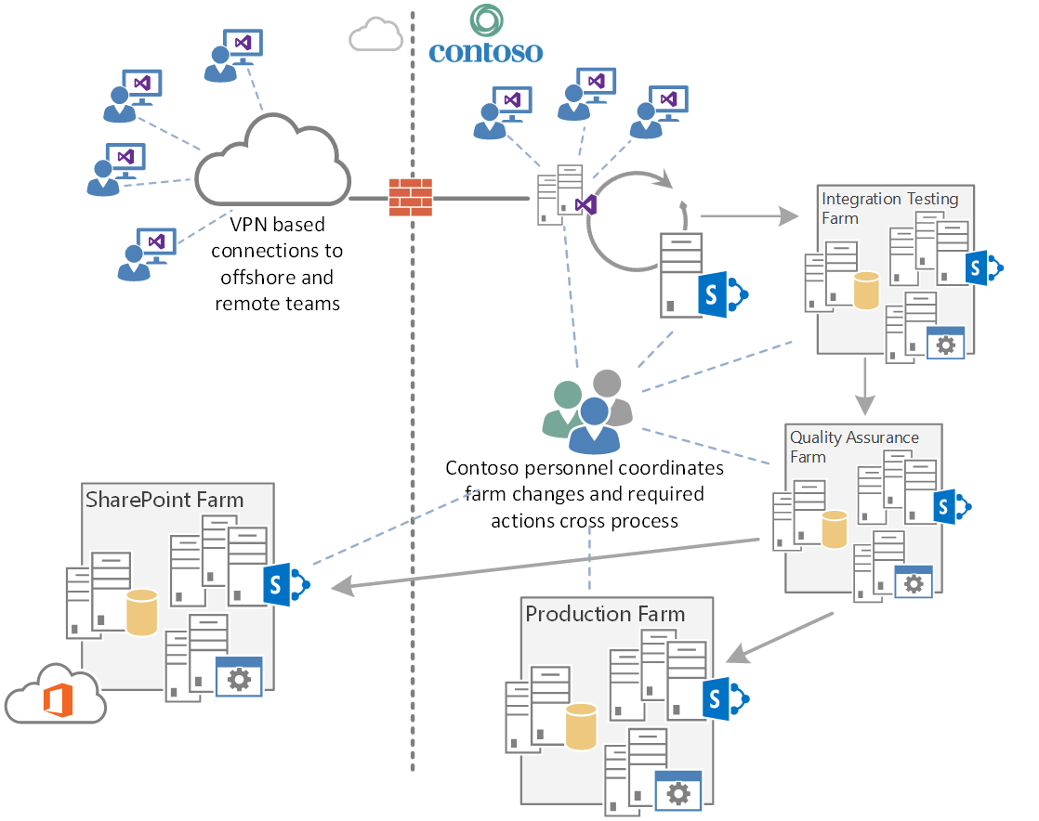
Current model with environments

Slide 27
New model with environments

Slide 28
ALM Processes
What
Microsoft’s approach to Application Lifecycle Management (ALM) provides a flexible and agile environment that adapts to team needs, removes barriers between roles, and streamlines processes so the focus is on delivering high-quality software faster and more efficiently.
Considerations
Methodology and template options
Team collaboration
DevOps
ALM Rangers guidance
Phase metrics
Complexity
Required time
Gained value
Notes:
Old section: ALM

Slide 29
Current model with ALM

Slide 30
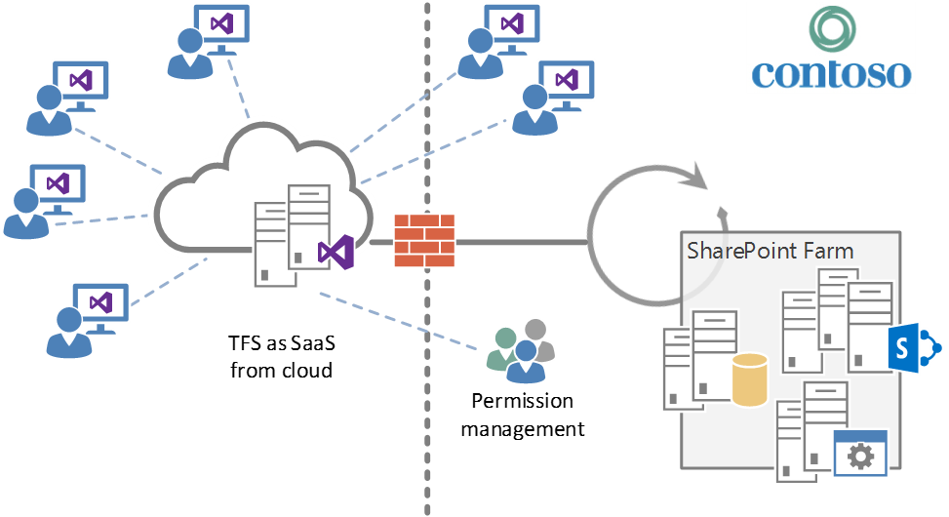
Future model with TFS

Slide 31

Provider Hosted App hosting

Slide 32
Provider Hosted Apps On Premises
What
An on premise IIS / ASP.NET farm responsible for hosting High Trust and Low trust Apps.
Considerations
Provider Hosted App farm should have same service level as the SharePoint farm.
Deployment guidelines should be defined for Provider Hosted Apps.
Policy for registration of High trust Apps should be defined
HTTPS should be enabled which requires either SNI or an established IP address management policy.
Phase metrics
Complexity
Required time
Gained value
Notes:
SNI: Server Name Indication

Slide 33
Provider Hosted Apps On Windows Azure
What
Provider Hosted Apps are hosted on Windows Azure Cloud Services and are leveraging Web Roles for scalability and performance reasons.
Considerations
Define guidelines for hosting a Provider Hosted App for on a Windows Azure cloud service
Deployment guidelines must be defined for Provider Hosted Apps.
Logging / monitoring / scaling guidelines should be defined.
Phase metrics
Complexity
Required time
Gained value

Slide 34
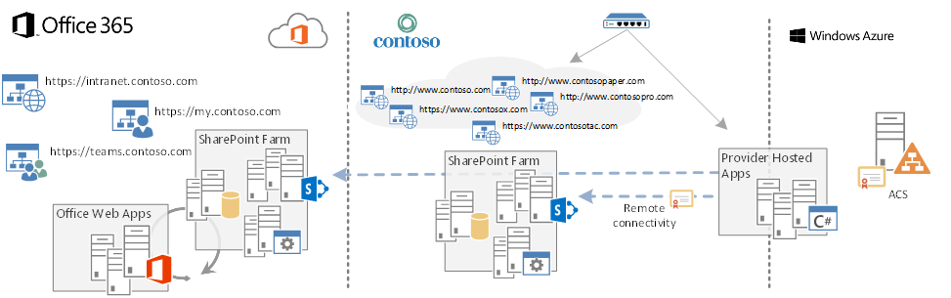
High level architecture

Slide 35

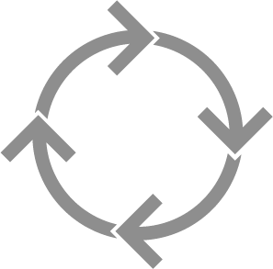
High level roadmap
Ju
Jan
Feb
Mar
Apr
May
Jun
Jul
Development environments and ALM
Application Developer guidance
Provider Hosted app hosting
Modern responsive apps

Slide 36
SharePoint Assessment report

Slide 37
Note:
The following slides are specific to your customer’s environment

Slide 38
FTC solutions analyzed
contoso.sharepoint.solution1.wsp
contoso.sharepoint.solution2.wsp
contoso.sharepoint.solution3.wsp
contoso.sharepoint.solution4.wsp
contoso.sharepoint.solution5.wsp
contoso.sharepoint.solution6.wsp
contoso.sharepoint.branding.wsp
contoso.sharepoint.solution7.wsp
contoso.sharepoint.solution8.wsp
northwind.mapping.wsp
northwind.compatibility.wsp
litware.sp2013.wsp
fabricam.locationfinder.wsp
tailspin.skillfinder.wsp

Slide 39
High level findings
The SharePoint farm contains unused solutions
contoso.sharepoint.solution7.wsp
contoso.sharepoint.solution8.wsp
Site provisioning is blended with the intranet solution
Should be separate solution
There are a number of list templates, which all have to be migrated before transition to Office 365 can be performed
Almost 2000 site collections (counting active, inactive and locked)

Slide 40
Note:
The following slides refer specifically to each solution

Slide 41
Contoso Solution 1
Currently in use at Contoso
Mainly scoped to the my site
Web parts on my site host
Limited use in collaboration sites
People can use the Web Parts in their site
Solution 1 cannot be moved to Office 365 due to FTC usage

Slide 42
App Maturity Level
Customer Preparedness
1
Branding
2
Remote provisioning
1
Composites and bus apps
3
Governance
2
Sync the tenant hosting setup
“Drive away from custom master”
Custom master
Theme
JS injection
Exists for one solution, but is not consistently used cross sites.
Existing solution is pretty sophisticated and could be used to address business requirements with other approaches. Web templates should not be used in new Office 365 platform.
1. Site collections
2. Assets (content types)
3. Sub sites
Move towards app model loosely coupled model.
How do we control customizations in SharePoint
How well are the solutions synced
Commitment to move from FTC to app model
ALM process
Notes:
The numbers on the slide signify the “App Maturity Level” in the scale of (0-3)
0 – For solutions that cannot be moved into the App model
3 - For solutions that are already using App model techniques

Slide 43
Customization overview

Slide 44
Note:
The following slides are specific to your customer’s environment

Slide 45
Contoso solutions
C – Complexity
E – Effort to move
Legend
Solution | C | E
contoso.sharepoint.solution1.wsp
contoso.sharepoint.solution2.wsp
contoso.sharepoint.solution3.wsp
contoso.sharepoint.solution4.wsp
contoso.sharepoint.solution5.wsp
contoso.sharepoint.branding.wsp
- Transform
- Abandon
- Unclear
- Easy to do
- Average
- Hard one

Slide 46
Third Party solutions
C – Complexity
E – Effort to move
Legend
- Transform
- Abandon
Solution | C | E
northwind.mapping.wsp
northwind.compatibility.wsp
litware.sp2013.wsp
fabricam.locationfinder.wsp
tailspin.skillfinder.wsp
- Unclear
- Easy to do
- Average
- Hard one

Slide 47

Branding
Branding
Complexity:
Medium
Owner: Contoso
High level requirements:
Typical Intranet features:
Custom web controls + page layouts
Custom branding (master page + CSS)
Social features (commenting, tag cloud)
Language specific search center site collections
Custom navigation
User Alerts
Custom Web parts / controls
Share price, world clock, weather, emergency information, image rotator
Other intranet features:
Site provisioning for collaborative sites
Team site metadata editing

Slide 48
Branding
Branding
Complexity:
Medium
Owner: Contoso
Migration
Light Branding can be achieved using Office 365 themes.
Medium branding on master page can be achieved through the use of alternate CSS.
SP Color tool provides color palette functionality for use with SharePoint designs.

Slide 49
Branding
Branding
Complexity:
Medium
Owner: Contoso
Challenges:
The many list definitions for the project sites will have a big migration impact (will take time to process)
Need to update all existing sites (branding) and pages (new page layouts) which will require proper tooling

Slide 50

Location Finder
LF
Complexity:
Complex
Owner: Fabrikam
High level requirements:
Should allow users to search for Fabrikam outlets
Should map the locations on interactive Bing Map
Migration:
Use search display templates to return search results.
Design notes and status
Solution already exists currently and is designed in right way
All capabilities which currently need full trust code, can be achieved using OOB capabilities in the app model implementation

Slide 51
Skill Finder
Skill Finder
Complexity:
Medium
Owner: TailSpin
High level requirements:
Allow users to search experts on the basis of their years of experience and past projects.
Allow the users to be able to communicate with the experts using a tool.
Design notes and status
The solution can be replaced using the SharePoint People search
The People search provides integration with Lync which can then be used to communicate with the expert using messaging or voice call.
TailSpin

Slide 52
Summary and initial solution design direction

Slide 53
Who’s responsible for what+ dependencies
Solution 6
Branding
Skill Finder
Solution 4
Location Finder
Solution 1
Solution 3
Branding
Solution 5
Solution 2
External Access
Fabrikam
Contoso
Another Vendor

Slide 54
Future model
Functionality A (Sol 4 / Sol 5)
Solution 1/ Solution 2
Framework A
Core features
(Sol 3/Sol 6)
Dependent App
(CP)
Dependent App
(??)

Slide 55
Contoso Office 365 logical architecture
Contoso Intranet
Contoso My Sites
Contoso Collaboration
Page layouts
Notifications
Team site
OOB Web parts
3rd party alternatives?
Project site
JavaScript customizations
Provider hosted apps
Contoso Framework
Provisioning
Timer Jobs
Branding
Development
Transformation

Slide 56
Framework
Framework = Agreed way to implement needed capabilities to align used models to product and service roadmap

Slide 57
Development focus areas
Provisioning framework
Remote timer framework
Branding and asset framework
Development framework
Transformation framework
Currently features are spread across multiple solutions.
Should just be one provisioning engine which takes care of the all required customizations.
Remove usage of feature framework elements and deploy assets using remote provisioning.
Require cross multiple solutions to perform disconnected asynchronous operations.
Updates to the existing functionalities to match app model techniques.
Branding topics.
Example: Needed JavaScript for header and footer capability in the Branding solution to avoid custom master page
What goes to SP, what goes to CDN?
Chosen hosting platform impacts the detailed design of the capabilities for Office 365 apps directly. Framework needs to support both cloud and on-prem.
General design and guidance for the provider hosted app implementation missing. Typical topics are logging and caching techniques.
General design on removing FTC solutions.
Transformation tooling, like updating existing master pages or transforming custom list templates to new app model format.
Notes:
CDN – Content Delivery Network

Slide 58
Provisioning framework
Typically a provider hosted app using CSOM to remotely create site collections and sub sites
All changes are applied from code:
Creating site columns and content types
Applying branding
Uploading page layouts
Adding web parts
…
Can also be used for publishing sites if needed

Slide 59
Remote timer job framework
One proven solution model for remote timer jobs
Does not necessarily required shared code, rather agreed pattern on how to implement remote timer jobs at Contoso
Reference implementation and knowledge sharing on used patterns
Utilize proven pattern, rather than reinventing the wheel

Slide 60
Branding and asset framework
Use CSS and JavaScript instead of custom master pages
Use a custom action to inject a piece of JavaScript on each and every page
Intelligent caching to increase performance (HTML 5 storage / cookies / CDN)
Use documented patterns on how assets are deployed
Guidance on how assets will be updated and what are the rules
What goes to SP and what goes to CDN (content delivery network)

Slide 61
Development framework
Application life cycle (ALM) model for app model implementation
Development model standardization, like no actual VMs for developers by default to promote the app model development practices
General design and guidance for the provider hosted app implementation. Typical topics are logging and caching techniques.
Patterns to use (e.g. SPA, MVC,…)

Slide 62
Transformation framework
Patterns on how to remove FTC dependency from solutions
Shared tooling to address FTC to app model transition across all solutions and projects
Use cases are identical across solutions
Creation of the transformation patterns and necessary tools using the available community work and guidance
Does not have to be months and months project, just high level documentation
Tools and processes gradually come from projects and are shared across others

Slide 63
Next steps

Slide 64
Application Modernization PnP Transformation Approach
Customer Preparedness
Solution Assessment
Architecture Session
STEP 1
Empower & Plan
App hosting configuration. Leverage available resources to ramp up Dev resources
Analyze solution inventory / requirements and provide guidance on solution modernization
Provide architecture design guidance for selected scenarios
Deliverable:
Successful smoke test app to validate configuration
Deliverable:
Assessment report
Deliverable:
Architecture Design Report
Development SOW (optional)
Development & Testing
Deployment
STEP 2
Develop & Deploy
Jointly work on development and testing with MS partners
Retract FTC
Deploy App solutions
Deliverable:
Tested solution artifacts
Deployment Guide
Deliverable:
Replace FTC by APP
Project signoff
Notes:
FTC: Full Trust Code
SOW: Statement of Work

Slide 65
Note:
Add specific next steps if needed

Slide 67

© 2015 Microsoft Corporation. All rights reserved. Microsoft, Windows, Windows Vista and other product names are or may be registered trademarks and/or trademarks in the U.S. and/or other countries.
The information herein is for informational purposes only and represents the current view of Microsoft Corporation as of the date of this presentation. Because Microsoft must respond to changing market conditions, it should not be interpreted to be a commitment on the part of Microsoft, and Microsoft cannot guarantee the accuracy of any information provided after the date of this presentation. MICROSOFT MAKES NO WARRANTIES, EXPRESS, IMPLIED OR STATUTORY, AS TO THE INFORMATION IN THIS PRESENTATION.

